Slide 1
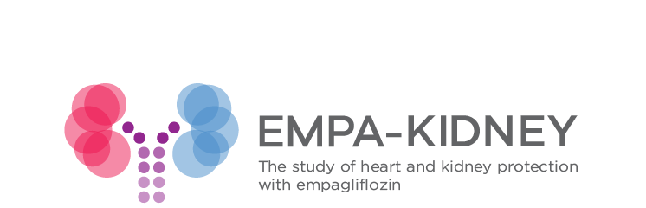
Oxford Results Evening
28th November 2022

Slide 2
Background and design

Slide 3
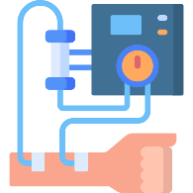
Rationale
Slower decline beginning later in life
Chronic kidney disease
Declines over time
Eventual outcome: dialysis or kidney transplant
Rate of decline varies by person
Aim: slow the rate of decline = delay dialysis/transplant
100
90
80
70
60
50
40
30
20
10
Moderate decline
Kidney function: eGFR
Fast decline
Kidney failure: dialysis/transplant
25 35 45 55 65 75
Age (years)

Slide 4
How can we slow the rate of decline?
Good control of blood pressure
Good control of blood sugar in people with diabetes
Drugs like ramipril or losartan for some people
Otherwise we don’t have long-term drug treatments for most people with chronic kidney disease
We need to test potential new treatments

Slide 5

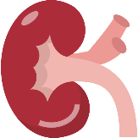


Goal
Age 52
Kidney disease
due to diabetes
eGFR 21
2021
Age 65
Kidney disease
due to high blood pressure
eGFR 26
2022
Age 41
Kidney disease
due to glomerulonephritis
eGFR 35
2024
2019

Slide 6

Goal
Age 52
Kidney disease
due to diabetes
eGFR 21
Empagliflozin
Age 65
Kidney disease
due to high blood pressure
eGFR 26
Empagliflozin
Age 41
Kidney disease
due to glomerulonephritis
eGFR 35
Empagliflozin
2019

Slide 7
Rationale
Empagliflozin is a drug used to treat type 2 diabetes
Diabetes trials found that it has other benefits and may slow progression of kidney disease
Works by causing loss of sugar and salt in urine
This protects the heart and kidneys
(Though we don’t yet understand exactly how)

Slide 8

Unanswered questions prior to EMPA-KIDNEY
Does it work if you don’t have diabetes?
Does it work in later stages of kidney disease?
Does it work if you don’t have albumin (protein) in the urine?

Slide 9


Aim
To test whether empagliflozin reduces the risk of kidney disease progression or dying from heart (cardiovascular) disease in a wide-range of people with kidney disease
Why heart (cardiovascular) disease too?
Heart disease is the commonest cause of death in people with kidney disease

Slide 10


How do we do that?
50% take the drug (empagliflozin)
50% take the dummy pill (placebo)

Slide 11

How do we do that?
50% take the drug (empagliflozin)
50% take the dummy pill (placebo)
Neither participants nor researchers know which they’re taking (“blinded”)
Compare outcomes in both groups to measure the effects of empagliflozin

Slide 12

How do we measure the effects?
Count the number of “primary outcomes” in those who took empagliflozin vs placebo & compare
Primary composite outcome
    Death from heart (cardiovascular) disease
    Kidney disease progression
OR
Starts dialysis or receives transplant during the trial
Dies during the trial because of kidney failure
Meets specific criteria based on change in eGFR during the trial

Slide 13


Who was eligible for the trial?
Kidney disease due to any cause
(except polycystic kidney disease)
Not received a kidney transplant
eGFR between 20 and 90
  If between 45 and 90, also required a certain level of albumin (protein) in the urine

Slide 14

Follow-up
Randomisation
2 months later
6 months later
Every 6 months thereafter
How is your health?
Has anything changed?
Blood pressure checked and weight measured
Blood samples taken to test kidney function & monitor safety
Are you happy to continue?
Given further supply of empagliflozin or placebo

Slide 15





EMPA-KIDNEY timeline
150 participants had begun dialysis or had a transplant
15th May 2019
First participant randomly allocated
22nd Feb 2022
“Formal interim analysis”
7th Mar 2022
Expert panel advised stopping early
1st Apr 2022
Final follow-up visits began
5th Jul 2022
Final follow-up completed
Is the trial progressing appropriately?
Should the trial continue or should it stop because:
the drug is SO good we may have the answer now
the drug clearly doesn’t work or may be causing harm

Slide 16
Recruitment and baseline characteristics

Slide 17
Impact of COVID-19
First participant randomised
15th May 2019
Last participant randomised
16th Apr 2021

Slide 18
Global totals
Canada | 488
China | 986
Germany | 1269
Italy | 246
Japan | 612
Malaysia | 646
United Kingdom | 1133
United States | 1229
Total | 6609

Slide 19
Diabetes status
No diabetes
54%
Diabetes
46%

Slide 20
Starting kidney function (eGFR)
Overall average starting eGFR: 37 ml/min/1.73m²
CKD stage 4
eGFR <30
35%
CKD stage 2-3A
eGFR 45-90
21%
CKD stage 3B
eGFR 30-44
44%

Slide 21
Starting level of albumin in the urine (uACR)
Overall average starting uACR: 37 mg/mmol
Low
20%
High
52%
Moderate
28%

Slide 22

Age, sex and race
Other 1.5%
Female
33%
Asian
36%
White
58.5%
Male
67%
Black 4%
Sex
Age
Race
Average: 64 years

Slide 23
Causes of kidney disease
Unknown
10%
Focal segmental glomerulosclerosis
Other
12%
N=195
Other glomerulonephritis
Hypertensive/ renovascular
22%
Glomerular disease
25%
N=657
N=817
Diabetic kidney disease
31%
IgA nephropathy

Slide 24
Follow-up completeness, quality & adherence

Slide 25
Follow-up & adherence
Median follow-up 2.0 (IQR 1.5-2.4) years
Completeness of follow-up Empagliflozin 99.1%
Placebo 99.2%
Adherence to study treatment Empagliflozin 89.6%
at 12 months Placebo 90.3%

Slide 26
Main results (part I)
Primary & kidney disease outcomes

Slide 27
Main result: kidney disease progression or cardiovascular death
In those allocated to PLACEBO:
558 out of 3305 people (16.9%) had one of these outcomes
40
30
Participants with Event (%)
20
10
0
0
0.5
1
1.5
2
2.5
Years of Follow-up

Slide 28
Main result: kidney disease progression or cardiovascular death
In those allocated to PLACEBO:
558 out of 3305 people (16.9%) had one of these outcomes
In those allocated to EMPAGLIFLOZIN:
432 out of 3304 people (13.1%) had one of these outcomes
40
30
Participants with Event (%)
20
10
0
0
0.5
1
1.5
2
2.5
Years of Follow-up

Slide 29
Main result: kidney disease progression or cardiovascular death
In those allocated to PLACEBO:
558 out of 3305 people (16.9%) had one of these outcomes
In those allocated to EMPAGLIFLOZIN:
432 out of 3304 people (13.1%) had one of these outcomes
40
30
20
Participants with Event (%)
The absolute risk of kidney disease progression or dying from heart (cardiovascular) disease in EMPA-KIDNEY participants is reduced by 3.8% by taking empagliflozin
10
0
0
0.5
1
1.5
2
2.5
Years of Follow-up

Slide 30
Kidney disease progression or death from heart (cardiovascular) disease
Primary composite outcome
    Death from heart (cardiovascular) disease
    Kidney disease progression
OR
Starts dialysis or receives transplant during the trial
Dies during the trial because of kidney failure
Meets specific criteria based on change in eGFR during the trial

Slide 31
Kidney disease progression or death from heart (cardiovascular) disease
Primary composite outcome
    Death from heart (cardiovascular) disease
    Kidney disease progression
OR
In total 990 participants had kidney disease progression OR died from cardiovascular disease

Slide 32
Both components examined separately
    Kidney disease progression
40
In those allocated to PLACEBO:
504 out of 3305 people (15.2%)
In those allocated to EMPAGLIFLOZIN:
384 out of 3304 people (11.6%)
30
Participants with Event (%)
20
10
0
0
0.5
1
1.5
2
2.5
Years of Follow-up

Slide 33
Both components examined separately
    Kidney disease progression
    Death from heart (cardiovascular) disease
40
40
In those allocated to PLACEBO:
504 out of 3305 people (15.2%)
In those allocated to EMPAGLIFLOZIN:
384 out of 3304 people (11.6%)
In those allocated to PLACEBO:
69 out of 3305 people (2.1%)
In those allocated to EMPAGLIFLOZIN:
59 out of 3304 people (1.8%)
30
30
Participants with Event (%)
20
20
10
10
0
0
0
0.5
1
1.5
2
2.5
0
0.5
1
1.5
2
2.5
Years of Follow-up
Years of Follow-up

Slide 34
Both components examined separately
    Kidney disease progression
    Death from heart (cardiovascular) disease
40
40
In those allocated to PLACEBO:
504 out of 3305 people (15.2%)
In those allocated to EMPAGLIFLOZIN:
384 out of 3304 people (11.6%)
In those allocated to PLACEBO:
69 out of 3305 people (2.1%)
In those allocated to EMPAGLIFLOZIN:
59 out of 3304 people (1.8%)
30
30
Participants with Event (%)
20
20
10
The absolute risk is reduced by 3.6%
The absolute risk is reduced by 0.3%
10
0
0
0
0.5
1
1.5
2
2.5
0
0.5
1
1.5
2
2.5
Years of Follow-up
Years of Follow-up

Slide 35
Primary outcome:
Key subgroups

Slide 36
Unanswered questions prior to EMPA-KIDNEY
Does it work if you don’t have diabetes?
Does it work in later stages of kidney disease?
Does it work if you don’t have protein (albumin) in the urine?
Pre-specified as key subgroups

Slide 37
Effect of diabetes on kidney disease progression/cardiovascular death

Slide 38
Effect of kidney function (eGFR) on kidney disease progression/cardiovascular death

Slide 39
Effect of level of albumin (protein) in the urine on kidney disease progression/cardiovascular death

Slide 40
Other subgroups
Empagliflozin reduced the risk of kidney disease progression or cardiovascular death regardless of:
Age
Sex
Geographical region
Cause of kidney disease
Body mass index
Blood pressure
Whether taking certain medications or not
Having diabetes or not
Having pre-existing heart disease or not
Level of kidney function (eGFR)
Level of albumin in the urine (uACR)
Levels of other blood markers

Slide 41
However…
Only small numbers of people with low levels of albumin in the urine had a primary outcome event
Because by definition their kidney disease progresses slowly
The trial was only 2 years long for the average person
Which may not be long enough to accurately assess effects in these slowly-progressing participants
We can analyse this group another way…

Slide 42
eGFR slope analyses

Slide 43
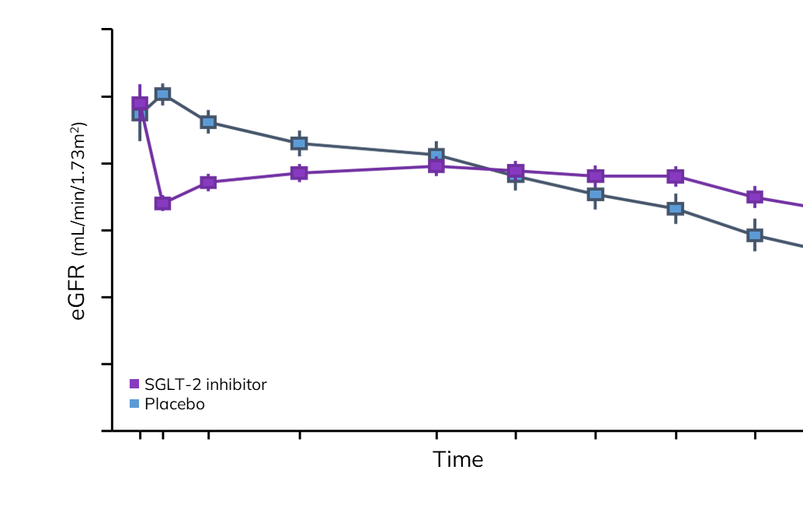
eGFR (kidney function) slope analyses
Assess the change in eGFR over time for all participants
Rather than counting numbers of outcomes/events

Slide 44
Annual rate of change of eGFR
40
Placebo
35
eGFR, mL/min/1.73m²
30
Chronic slope in mL/min/1.73m² per year
 | Placebo Mean (SE)
 | -2.75 (0.08)
25
0
2
6
12
18
24
30
36
Months
v
.

Slide 45
Annual rate of change of eGFR
40
Empagliflozin
Placebo
35
eGFR, mL/min/1.73m²
30
Chronic slope in mL/min/1.73m² per year
 | Placebo Mean (SE)
 | -2.75 (0.08)
25
0
2
6
12
18
24
30
36
Months
v
.

Slide 46
Annual rate of change of eGFR
40
Empagliflozin
Placebo
35
eGFR, mL/min/1.73m²
30
Chronic slope in mL/min/1.73m² per year
Empagliflozin Mean (SE) | Placebo Mean (SE) | Difference (95% CI)
-1.37 (0.08) | -2.75 (0.08) | 1.37 (1.16, 1.59)
25
0
2
6
12
18
24
30
36
Months
v
.

Slide 47
Annual rate of change of eGFR
40
Empagliflozin
Placebo
Difference of at least 0.5 is considered effective
35
eGFR, mL/min/1.73m²
30
Chronic slope in mL/min/1.73m² per year
Empagliflozin Mean (SE) | Placebo Mean (SE) | Difference (95% CI)
-1.37 (0.08) | -2.75 (0.08) | 1.37 (1.16, 1.59)
25
0
2
6
12
18
24
30
36
Months
v
.

Slide 48
What does it mean?
In chronic kidney disease, kidney function (eGFR) declines each year, at different rates depending on various factors
This may be around 1 unit of eGFR per year
Or as fast as 5 units of eGFR per year in those progressing rapidly
Empagliflozin prevented loss of 1.4 units of eGFR per year
Which effectively means halting progression in those progressing slowly
And considerably delaying progression and increasing the time until dialysis is required for those progressing more quickly

Slide 49
eGFR slope analyses:
Key subgroups

Slide 50
Chronic eGFR slopes by albuminuria
Mean slope (SE)
mL/min/1.73m²/year
Difference between
Empagliflozin Placebo
mean slopes (95% CI)
All
-1.37 (0.08)
-2.75 (0.08)
1.37
(1.16, 1.59)
-1.0
0
1.0
2.0
Placebo Better
Empagliflozin Better

Slide 51
Chronic eGFR slopes by albuminuria
Mean slope (SE)
uACR
(mg/g)
mL/min/1.73m²/year
Difference between
mean slopes (95% CI)
<30
-0.89 (0.16)
≥30 <300
-1.69 (0.14)
≥300
-4.11 (0.11)
All
-2.75 (0.08)
1.37
(1.16, 1.59)
-1.0
0
1.0
2.0
Placebo Better
Empagliflozin Better

Slide 52
Chronic eGFR slopes by albuminuria
Mean slope (SE)
uACR
(mg/g)
mL/min/1.73m²/year
Difference between
Empagliflozin Placebo
mean slopes (95% CI)
<30
-0.11 (0.17)
-0.89 (0.16)
0.78
(0.32, 1.23)
≥30 <300
-0.49 (0.14)
-1.69 (0.14)
1.20
(0.81, 1.59)
≥300
-2.35 (0.11)
-4.11 (0.11)
1.76
(1.46, 2.05)
All
-1.37 (0.08)
-2.75 (0.08)
1.37
(1.16, 1.59)
-1.0
0
1.0
2.0
Placebo Better
Empagliflozin Better

Slide 53
Chronic eGFR slopes by albuminuria
Mean slope (SE)
uACR
(mg/g)
mL/min/1.73m²/year
Difference between
Empagliflozin Placebo
mean slopes (95% CI)
<30
-0.11 (0.17)
-0.89 (0.16)
0.78
(0.32, 1.23)
≥30 <300
-0.49 (0.14)
-1.69 (0.14)
1.20
(0.81, 1.59)
≥300
-2.35 (0.11)
-4.11 (0.11)
1.76
(1.46, 2.05)
All
-1.37 (0.08)
-2.75 (0.08)
1.37
(1.16, 1.59)
Difference of at least 0.5 is considered effective
-1.0
0
1.0
2.0
Placebo Better
Empagliflozin Better

Slide 54
Key secondary and other outcomes

Slide 55

Key secondary outcomes
Empagliflozin reduced the risk of hospital admission for any cause
Placebo group: 29.2 hospital admissions per 100 people/year
If 100 people were treated with empagliflozin for 1 year, there would be 4 fewer hospital admissions

Slide 56
Key secondary outcomes
Remember death from heart (cardiovascular) disease…
When combined with hospital admissions for heart failure in particular, there was no significant difference in those who received empagliflozin vs placebo
  We think these drugs probably DO reduce the risk of these events but numbers were too small in EMPA-KIDNEY to detect this
When we consider all deaths, regardless of cause, again there is no significant difference

Slide 57
Safety outcomes

Slide 58
Ketoacidosis
The bottom line: empagliflozin is safe
We knew previously that these drugs increase the risk of ketoacidosis
Empagliflozin did increase the risk of ketoacidosis but this only occurred in 6 people taking empagliflozin versus 1 taking placebo – it’s rare!

Slide 59
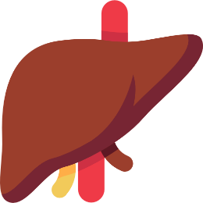
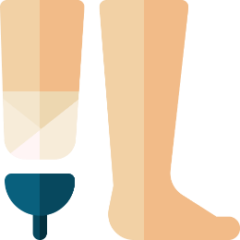
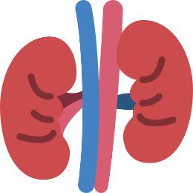





There was no effect on…
Liver injury
Amputations
Acute kidney injury
High blood potassium levels
Urinary or genital infections
Dehydration
Low blood sugar levels
Bone fractures

Slide 60
Physical measurements and biochemical outcomes

Slide 61

Physical measurements
 | Empagliflozin (n=3304) | Placebo (n=3305) | Difference (SE)
Weight (kg) | 82.3 | 83.2 | -0.9 (0.1)
Average body weight was ~1kg lower in those taking empagliflozin vs placebo over the course of the trial

Slide 62
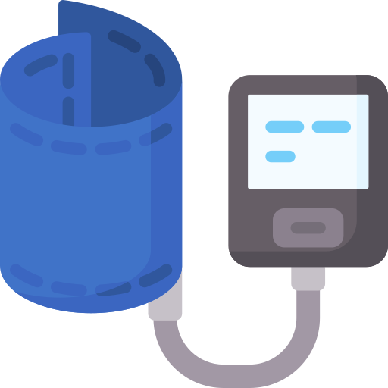
Physical measurements
 | Empagliflozin (n=3304) | Placebo (n=3305) | Difference (SE)
Systolic BP (mmHg) | 132.8 | 135.3 | -2.6 (0.3)
Diastolic BP (mmHg) | 76.3 | 76.8 | -0.5 (0.2)
Average blood pressure was very slightly lower in those taking empagliflozin vs placebo over the course of the trial

Slide 63
Level of albumin (protein) in the urine
 | Empagliflozin (N=3304) | Placebo (N=3305) | Proportional difference (95% CI)
Geometric mean urinary ACR (mg/g) | 205 | 261 | 0.81 (0.77-0.86)
Average level of albumin (protein) in the urine was lower in those taking empagliflozin vs placebo over the course of the trial

Slide 64
EMPA-KIDNEY Conclusions
Randomised 6609 patients with CKD with a broad range of causes, and large numbers with low levels of kidney function & albumin in the urine
Empagliflozin safely reduced the composite primary outcome of kidney disease progression or death from heart (cardiovascular) disease
All the different types of people included in the trial (eg, with or without diabetes, or stage of kidney disease) appeared to benefit
Notes:
Read slide!

Slide 65
What does it mean?
EMPA-KIDNEY confirms findings from other trials that SGLT2 inhibitors like empagliflozin are safe and effective for the treatment of chronic kidney disease in MOST people (other drugs: dapagliflozin, canagliflozin…)
What’s new?
The effects are observed even in people who don’t have diabetes
The drug is safe and effective at lower levels of kidney function – empagliflozin should be made available to people who are not currently eligible
There are benefits even in people with low levels of albumin (protein) in the urine
Notes:
Read slide!

Slide 66
What does it mean for me?
Doctors can already prescribe SGLT-2 inhibitors (like empagliflozin) for some people with chronic kidney disease
We hope these results will expand access
But the results needs to be reviewed by the government and NHS first
Please discuss with your kidney doctor when you next see them
Notes:
Read slide!

Slide 67
POST-TRIAL FOLLOW-UP

Slide 68


  Post-trial follow-up (PTFU): rationale
We know that empagliflozin slows CKD progression during treatment vs placebo
What happens beyond FFU/after stopping treatment?
Participant A
Empagliflozin
eGFR 26
eGFR 24
Dialysis delayed
Participant B
Placebo
eGFR 26
eGFR 21
2020
2022
2023
2025
During treatment phase
Post-trial follow-up

Slide 69
  Post-trial follow-up (PTFU)
Information will be collected from your kidney unit records if you have previously given consent for this
No further appointments required
Does not affect your routine medical treatment in any way
Participants are free to join other trials and continue PTFU

Slide 70
FUTURE PLANS

Slide 71

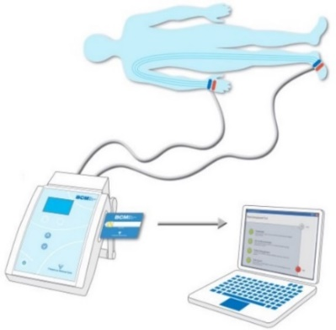

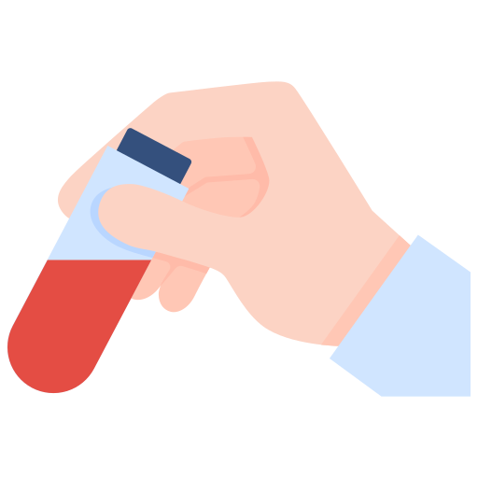


What’s next?
Regulatory submissions
MRI substudy
analysis & results
Bioimpedance substudy
analysis & results
Additional biomarker studies
Subsidiary analyses
**Future trials**

Slide 72





Acknowledgements
We thank the 6609 participants, members of the committees, and coordinating and local site staff who make up the EMPA-KIDNEY Collaborative Group
https://www.empakidney.org/our-collaborators
Notes:
And our deep thanks and gratitude go to the participants and all our collaborators.

Slide 73
… and thank you very much for attending this evening

Slide 74

QUESTIONS & DISCUSSION

